Slide 1
Overview of Combinatorial Test Design (CTD) with case study
Notes:
1

Slide 2
Presentation Outline
Learning Objective:
Participant will be able to understand how a Combinatorial Test Design (CTD) method helps teams get consistent coverage across the test space
Getting Started:
Introduction to CTD
Focus Tool
Case Studies

Slide 3
Introduction to CTD
A systematic test planning method to reduce test omissions providing consistent test coverage.
Test everything vs. CTD approach for testing
Test Everything
One approach to testing is to create tests that cover every combination of inputs or configurations, so that testers can state that everything was tested.
Testers manually generate the test cases that they believe will sufficiently cover the space.
In reality, the number of test cases that result from attempting to test all combinations far exceeds the time and resources available.
Many redundant tests are defined and there are large gaps in coverage.
CTD
Combinatorial Test Design (CTD) is a technique that avoids dealing with all combinations by focusing on a small number of combinations that are likely to expose most of the defects.
It consists of modeling the tested environment, identifying high risk combinations, and producing a test suite in which, all high risk combinations are covered.
Each test is as different as possible from all other tests.
Notes:
3

Slide 4
Issues CTD Addresses
Many teams today use an ad hoc design method for Test Planning which result in:
Too many test cases to create, execute and maintain
Lack of ability to identify which tests are missing
Lack of ability to quantify the risk of testing less or the value of testing more
Volumes of test results data that makes it difficult, or impossible to analyze result
Value that CTD Provides
Combinatorial Test Design provides a structured , tool based design methodology which result in:
A repeatable test design process that doesn't depend solely on the experience of the test team
Consistent coverage without test duplication
A test plan that is well positioned for effective test automation strategies
The minimum number of test cases needed for a known interaction level
Ability to answer the question, "Did you test that?"
Notes:
4

Slide 5
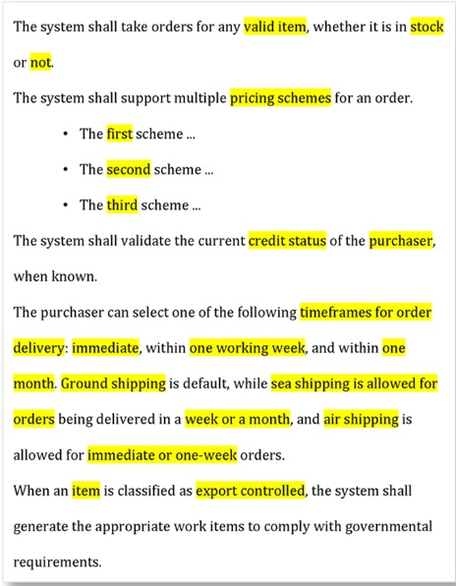
A Sample Test Scenario for Online Shopping
In traditional test planning, the answer to “how many tests” is usually “as many as I have time to write.”
When test cases are hand-written, we tend to create test cases with copy and paste.
Each time we paste, we tend to change only one or a couple of values for each test case.
The result is a test plan in which each test case is very similar to its predecessors and successors.
Notes:
5

Slide 6
How CTD works - Concepts
With CTD, you document the test requirements by creating a Model of the points of variability. This is the first step in test planning to create a model.
The points of variability in a system are called attributes.
These are the elements in the testing requirements that cause different navigation paths through the code.
Attributes include inputs or parameters to the system and the conditions that affect processing, and they can describe physical configurations, not only logical elements.
The different states of an attribute are called values, which can be represented as a String, Integers, or Booleans when designing a CTD model.
Notes:
6

Slide 7
Example of potential requirement text – Availability Attribute and Values
1
The system shall take orders for any valid item, whether it is in stock or not.
The system shall support multiple pricing schemes for an order.
o The first scheme ... [description omitted for demo]
o The second scheme ... [description omitted for demo]
o The third scheme ... [description omitted for demo]
The system shall validate the current credit status of the purchaser, when known.
The purchaser can select one of the following time frames for order delivery: immediate, within one working week, and within one month. Ground shipping is default, while sea shipping is allowed for orders being delivered in a week or a month, and air shipping is allowed for immediate or one-week orders.
When an item is classified as export controlled, the system shall generate the appropriate work items to comply with governmental requirements.
Availability
In Stock
Not in Stock
No Such Product

Slide 8
Example of potential requirement text – Pricing Scheme Attribute & Values
The system shall take orders for any valid item, whether it is in stock or not.
The system shall support multiple pricing schemes for an order.
o The first scheme ... [description omitted for demo]
o The second scheme ... [description omitted for demo]
o The third scheme ... [description omitted for demo]
The system shall validate the current credit status of the purchaser, when known.
The purchaser can select one of the following time frames for order delivery: immediate, within one working week, and within one month. Ground shipping is default, while sea shipping is allowed for orders being delivered in a week or a month, and air shipping is allowed for immediate or one-week orders.
When an item is classified as export controlled, the system shall generate the appropriate work items to comply with governmental requirements.
2
Pricing Scheme
Scheme 1
Scheme 2
Scheme 3

Slide 9
Example of potential requirement text – Credit Status Attribute and Values
The system shall take orders for any valid item, whether it is in stock or not.
The system shall support multiple pricing schemes for an order.
o The first scheme ... [description omitted for demo]
o The second scheme ... [description omitted for demo]
o The third scheme ... [description omitted for demo]
The system shall validate the current credit status of the purchaser, when known.
The purchaser can select one of the following time frames for order delivery: immediate, within one working week, and within one month. Ground shipping is default, while sea shipping is allowed for orders being delivered in a week or a month, and air shipping is allowed for immediate or one-week orders.
When an item is classified as export controlled, the system shall generate the appropriate work items to comply with governmental requirements.
Credit Status
Approved
Denied
Unknown
3

Slide 10
Example of potential requirement text – Additional Attributes and Values
The system shall take orders for any valid item, whether it is in stock or not.
The system shall support multiple pricing schemes for an order.
o The first scheme ... [description omitted for demo]
o The second scheme ... [description omitted for demo]
o The third scheme ... [description omitted for demo]
The system shall validate the current credit status of the purchaser, when known.
The purchaser can select one of the following time frames for order delivery: immediate, within one working week, and within one month. Ground shipping is default, while sea shipping is allowed for orders being delivered in a week or a month, and air shipping is allowed for immediate or one-week orders.
When an item is classified as export controlled, the system shall generate the appropriate work items to comply with governmental requirements.
4
5
6
7

Slide 11

Focus Tool
Tool designed by IBM’s Haifa Research
IBM Functional Coverage Unified Solution (IBM FOCUS) is an advanced test planning tool for improving the testing of an application.
IBM FOCUS uses Combinatorial Test Design (CTD) to generate an efficient test plan that provides consistent coverage across the test space at a known depth, while significantly reducing the required resources.
IBM FOCUS is independent of the application's domain and can be applied at different levels of testing.
Notes:
11

Slide 12
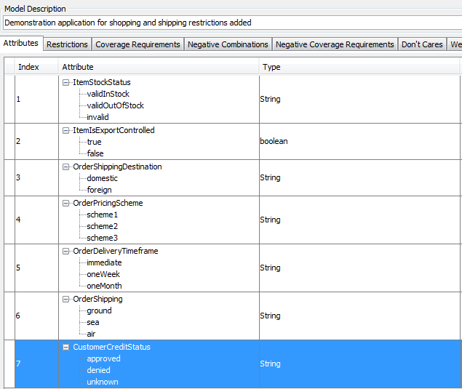
The corresponding model that gets created in CTD based on analysis of the requirements– attributes, their values, and restrictions
Each Attribute and it’s associated values are entered into FOCUS
Value can be explicit in the requirements or they can be implied
Restrictions should be identified for values that cannot occur
These will drive negative test scenarios

Slide 13
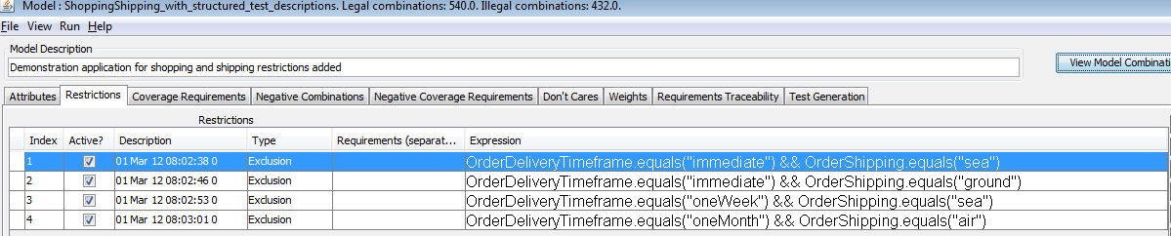
Each attribute, it’s type, its values, and corresponding restrictions are captured in CTD by using the GUI Interface.
The GUI allows the Attributes and Values to be entered
CTD will compute the total legal and illegal combinations of the entered attributes and values
CTD has computed 540 Legal & 432 Illegal combinations for the example set of attributes and values

Slide 14
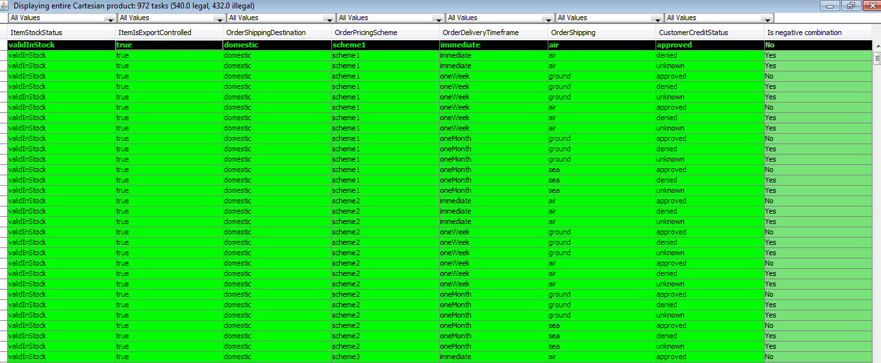
CTD provides an easy way to identify and exclude invalid combinations of attributes and values using the Cartesian Product command

Slide 15
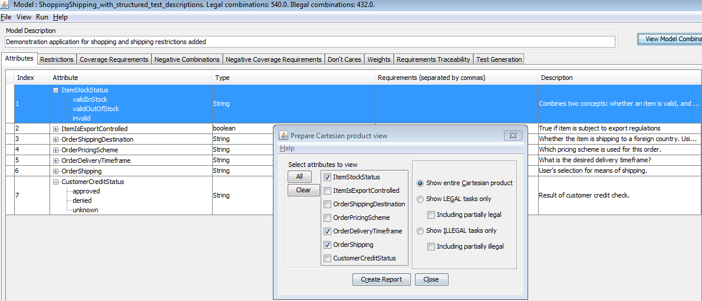
Creating a Cartesian Product view of Item availability, delivery schedule and shipping options

Slide 16
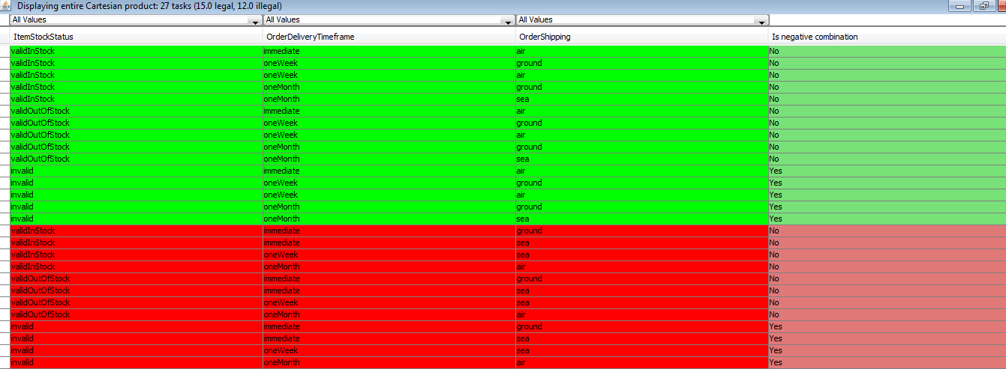
The Cartesian Product Report displays the legal and Illegal combinations
The report allows you to create restrictions by clicking on and excluding Legal Combinations.
Restrictions will be added for each combination which has been marked as illegal.

Slide 17
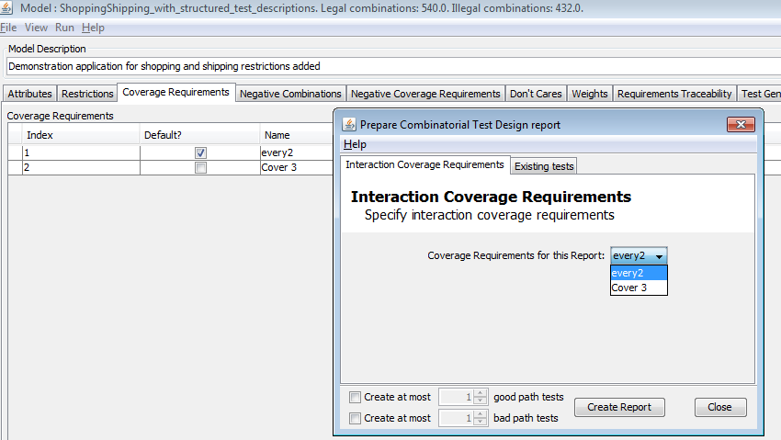
The Combinatorial Test Design command generates optimal test plans from the model, with user-controlled test intensity

Slide 18
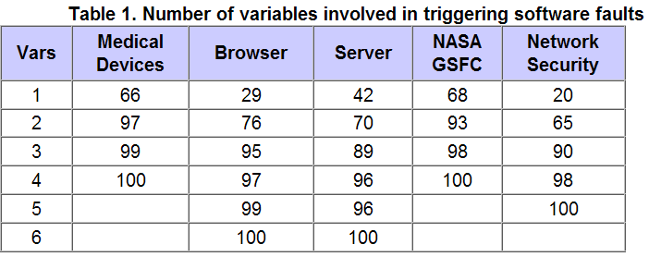
Do we really need to test all 972 (or even 540) configurations?
The root cause analysis of many bugs is tracked back to a specific value of one variable (20%-68%)
Most defects are discovered in tests of the interactions between the values of two configuration variables (66-97%)
So, to balance cost and risk, we look to select a subset of tests that covers the interactions of configuration variables at some level of interaction (pairs, three-way, etc.)
Source http://csrc.nist.gov/groups/SNS/acts/ftfi.html used in slides 6,8,9

Slide 19
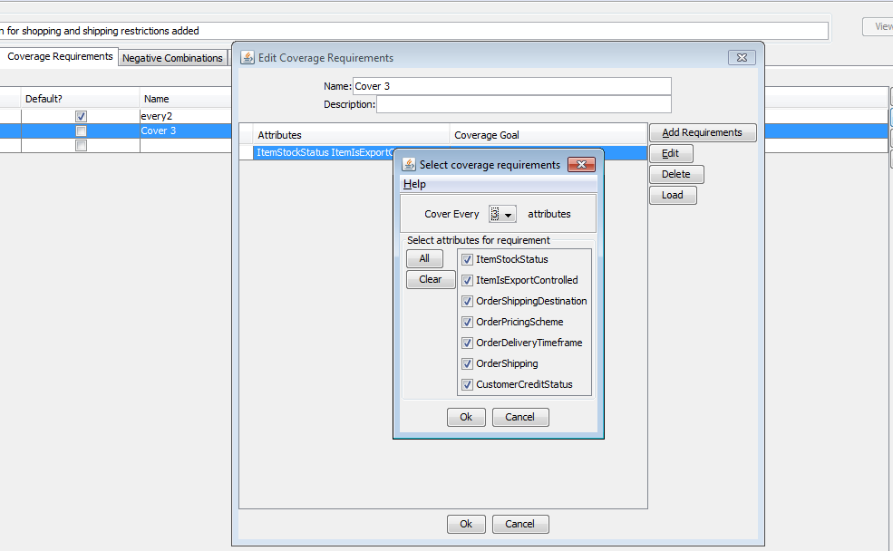
You can select the level of test intensity by selecting the level of coverage for the attributes

Slide 20
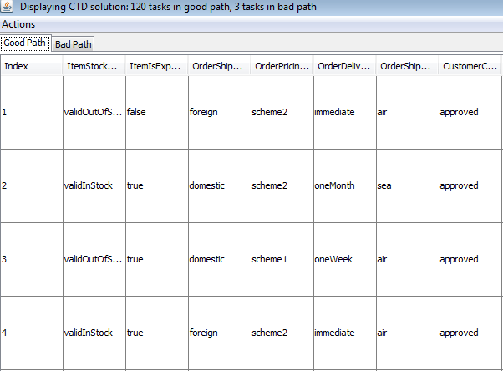
The current model generates 123 combinations to be tested, 120 Good Path & 3 Bad Path
Available, Pricing Scheme 1
Available, Pricing Scheme 2
Available, Pricing Scheme 3
Pricing Scheme 1, Good Credit
Pricing Scheme 1, Bad Credit
etc
Why Look at ALL Pairs?

Slide 21
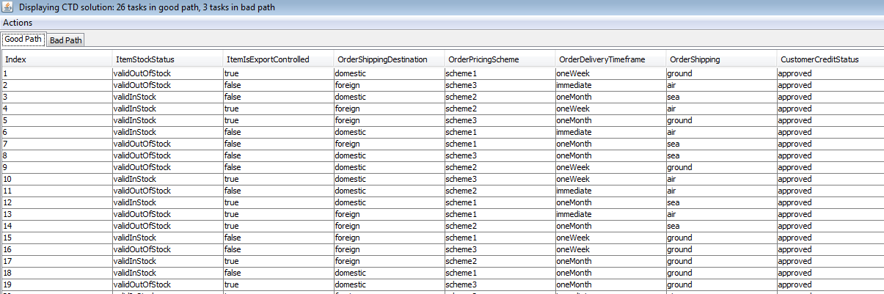
CTD models all 123 pair-wise interactions with just 29 tests, 26 Good & 3 Bad path
The CTD model groups the attributes and values into a model which provides coverage of all the values in the least amount of required test cases

Slide 22
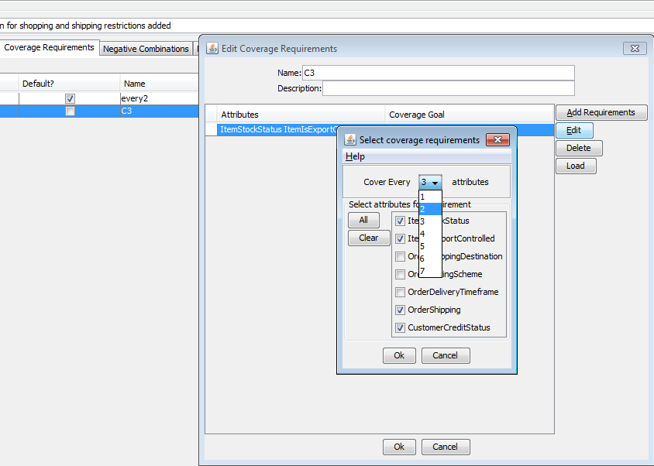
Testing intensity does not need to be uniform: we can specify collections of attributes to be tested more thoroughly than pair-wise, up to 7-attribute testing

Slide 23
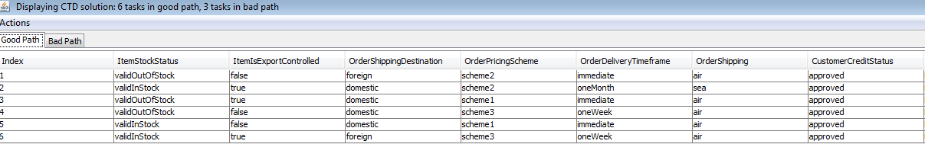
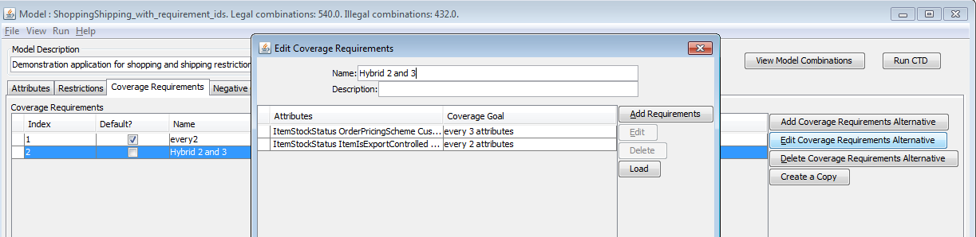
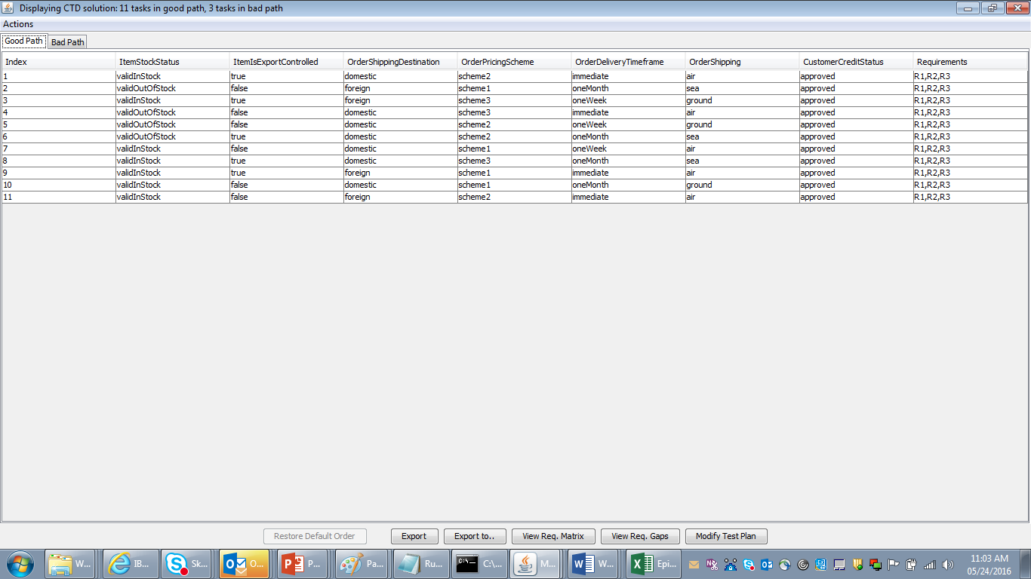
Testing all three-way interactions of Availability, Pricing, and Credit: 9 test cases, 6 good & 3 bad path
Note: You can also combine interaction levels. You could take the three-way interaction of Availability, Pricing & Credit plus the two-way interaction of all variables and generate a test plan. In that case, you’d get 11 good & 3 bad path test cases.

Slide 24
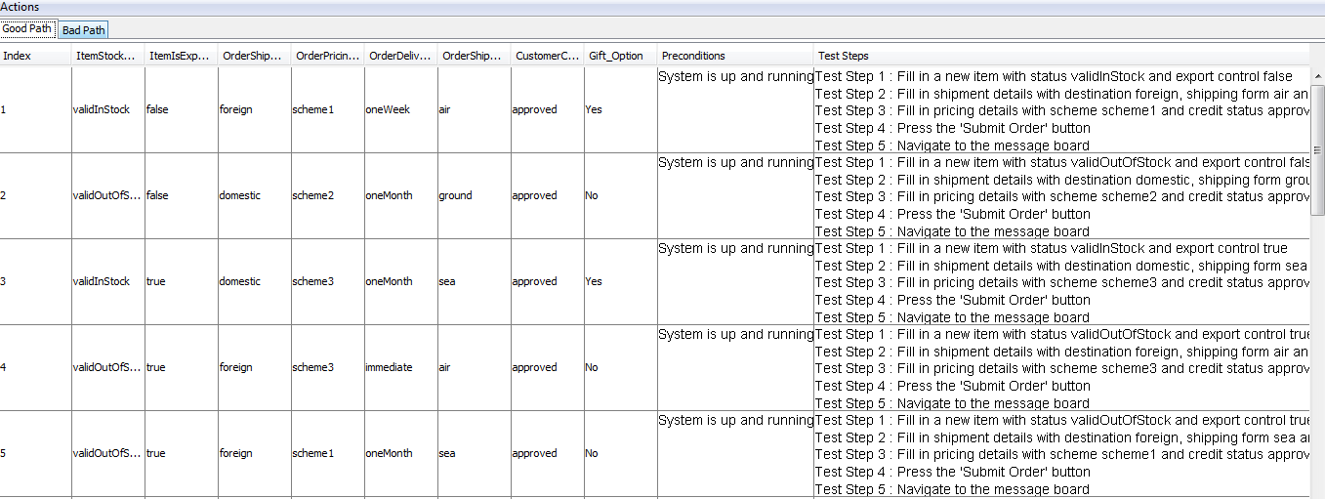
Sample CTD Output based on Templates

Slide 25
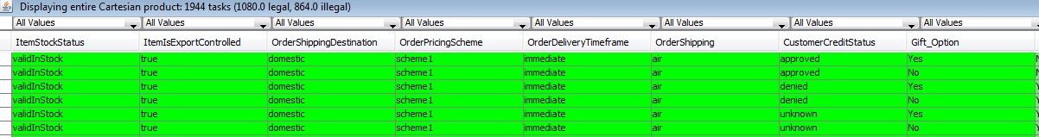
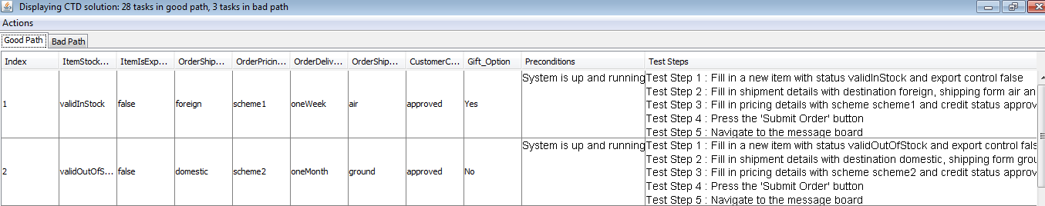
Impact of adding a new attribute to the model – Gift Option
Cartesian Product Changes
Before it was 942 , 540 Legal & 432 Illegal
CTD Output Changes for Level 3
Before it was 26 good path & 3 bad path

Slide 26
Coming soon…Automation of the CTD output using Selenium for Web Testing

Slide 27
Case Study Insurance Industry
Number of Test Scenarios Identified after the discussion with business : 30
Number of Test cases identified to test the above mentioned scenarios : 474
Note: The test cases excludes negative test conditions
CTD Benefit:
CTD proposed 44 Test Cases with 31 positive and 13 negative test conditions
Time taken to execute 474 test conditions via Automation | 55 PH
Time taken to execute 44 test conditions as proposed by CTD via Automation | 5 PH
Total Time Saved Just in Execution | 91%
Impact:
Fewer TCs written
Fewer TCs executed
Fewer TCs for automation

Slide 28
Analysis of one client’s “high confidence” test set. Inefficient. Low requirements coverage. Client was surprised.
IBM’s approach delivers lowest test case volume with highest coverage
It is important to leverage your test case investments while improving the coverage
100%
100%
100%
53
Legend
% Coverage
# New Tests
# Existing Tests
112
112
53
53
26.4%
26.4%
18
13
Existing Tests
CTD From Scratch
Test Selection
Enhancement
Enhance Select
Traditional test planning delivers low functional coverage in-spite of reasonably high test case volumes
30%-70% test case redundancy is typical
Significant cost implications for both manual and automation initiatives

Slide 29

Data Processing CTD Case Study for Major Financial Company
Business Value
Client objectives
Focus on data processing of a single report type
Existing test suites consist of 256 tests for regression, and 6 for end-to-end system integration test (SIT)
Effectiveness of existing tests is of concern
Creating new tests, and new data for them, requires relatively large effort
Huge test space to choose from. Number of valid tests is a 25-digit number.
IBM solution
Utilizing IBM’s CTD offering:
Create a model capturing the points of variability in the tests
Analyze coverage of existing test suites
Suggest a new test plan that achieves 100% coverage
Suggest an alternative that reuses existing data as much as possible
Using advanced CTD features, minimize required amount of test data in suggested tests
Existing test suites achieve 27-45% coverage in good path, and 0-5% in bad path
Suggested a new test plan, consisting of 16 tests, that achieves 100% coverage
Suggested an alternative test plan, consisting of 27 tests, with all but 9 reusing existing test data
Further reduced required amounts of new test data from 309 items to 224
Suggested bad-path test plans consisting of 20 and 54 tests (for different coverage requirements)
Notes:
29
29

Slide 30
High Availability Recovery Subsystem enhances testing with Combinatorial Test Design
Client objectives
Model a test plan with all possible recovery actions as current testing had not done a good job of covering the possibilities
Regain customer trust after two outages in six months
Avoid further outages
Shorten testing cycles in System Integration Testing
IBM solution
Utilized IBM’s Combinatorial Design offering to develop a functional model of the system in cooperation with the development and test teams
Output model contained 100 tests which was substantially down from the 7800 possible tests
Further analysis brought this down to 21 tests
Business Value
Reduced testing cycle by an order of magnitude
Improved defect discovery and decreased defect escapes into production by creating highly efficient tests – averaged approximately 1 defect per test case executed
No more outages in two years after creation of new tests
Notes:
30
30

Slide 31
Current ETS Pilot Status
Waterfall - PJ# 020801 - Reference Table Enhancement for Texas IA taxation
Milestones:
CTD Model & HLTC generation – Completed – (04/15)
TCB review & approval of HLTC – Completed – (04/22)
HLTC Review by Project /Business team – Completed – (04/26)
Update of Project/Business team comments – Completed – (05/03)
HLTC upload in ALM – Completed – (05/04)
Waterfall - PJ#020773 - Lease Co Phase 3 (Epic # : 717)
Scrum teams: Hulk, Gravity, Narwhals, MRT (Working on it part of PSI 19 & 20)
Milestones:
CTD Model creation & HLTC generation for ETS Waterfall scope – Completed – (04/29)
Internal review of CTD model – Completed. – (05/05)
TCB review of HLTC – Completed. – (05/12)
HLTC Review by Business/Project team – In Progress (ETC – 05/27)
Scrum Only - PJ020681 – RMS – Point of Sales Changes
Milestones:
CTD Model creation & HLTC generation for Agile scope – Completed
Internal review of CTD model – Completed
HLTC Review by Business/Project team – In Progress (HLTCs were sent to business for sign off – expecting a response) - ETC -5/27
Waterfall - PJ020449 – Prepaid IB (doing as a review of past work)
Milestones:
Requirement / IA analysis along with Sprint SMEs – In Progress (85% completed ) (ETC – 5/27)
CTD Model Creation – Not started (ETC – 5/31)

Slide 32











Hindi
Thai
Gracias
Traditional Chinese
Russian
Spanish
Obrigado
Brazilian Portuguese
Arabic
Danke
Grazie
Merci
Italian
German
French
Tamil
Simplified Chinese
Japanese
Korean

Slide 33
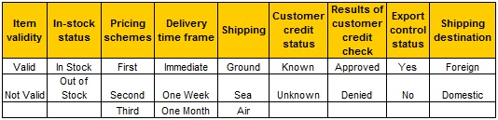
Attribute & Values for a CTD Model
Number of combinations = n1 x n2 x n3 x n4 x n5 x n6 x n7 x n8 x n9 = 2 x 2 x 3 x 3 x 3 x 2 x 2 x 2 x 2 = 1,728
Create a CTD Model
Identify all the attributes
Input or parameters to the product
Conditions that affect processing
Missed variables will not get tested
Establish values for each variable
Explore values that could drive different logic or behavior
Use equivalence classes and boundary conditions
Explicitly capture Default as value
Include good and error value
Consider restrictions
Look for combinations of values that cannot occur
Notes:
33

